Slide 1
ROC AUC Curve
The ROC AUC curve is a key tool for evaluating binary classification models, showing how well a model distinguishes between classes across different thresholds.

Slide 2
ROC
ROC stands for Receiver Operating Characteristic.
It plots the True Positive Rate (TPR) against the
False Positive Rate (FPR) at various threshold settings.
TPR (Recall/Sensitivity): Proportion of actual positives correctly identified.
FPR: Proportion of actual negatives incorrectly identified as positives.

Slide 3
AUC
AUC stands for Area Under the Curve.
It quantifies the overall ability of the model to discriminate between positive and negative classes.
AUC ranges from 0 to 1:
1.0 = perfect classification.
0.5 = no discrimination (equivalent to random guessing).
< 0.5 = worse than random (model is misclassifying).

Slide 4
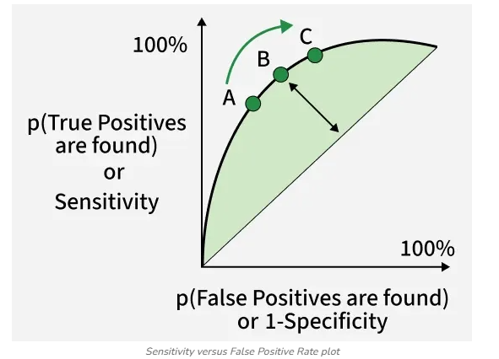
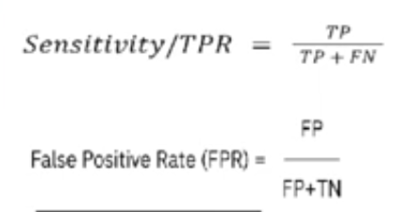
Calculate ROC

Slide 5
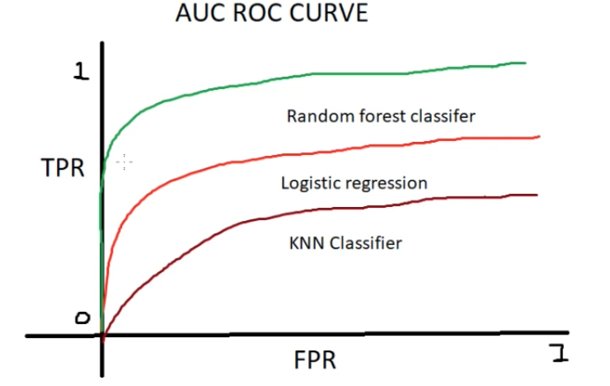
Why Use ROC AUC?
It evaluates model performance across all classification thresholds, unlike accuracy which depends on a single threshold.
A model with a higher ROC curve and larger AUC is generally better.
Random Forest Classifier have greater AuC
so this model is best for this dataset

